Slide 1




Northeast Florida Regional Council Military Installation Resilience Review
Technical Advisory
Committee
September 30, 2025

Slide 2
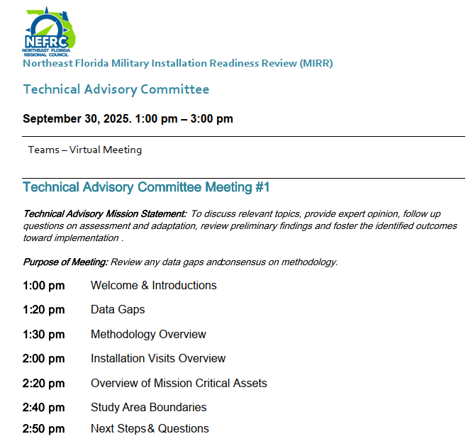
Agenda

Slide 3
Agenda
Meeting Purpose: Review data gaps and gain consensus on the methodology.
1:00 pm Welcome and Introductions
1:20 pm Data Gaps
1:30 pm Methodology Overview
2:00 pm Installation Visits Overview
2:20 pm Overview of Mission Critical Assets
2:40 pm Study Area Boundaries
2:50 pm Next Steps & Questions

Slide 4
Welcome & Introductions
Notes:
Susy

Slide 5
Introductions

Slide 6
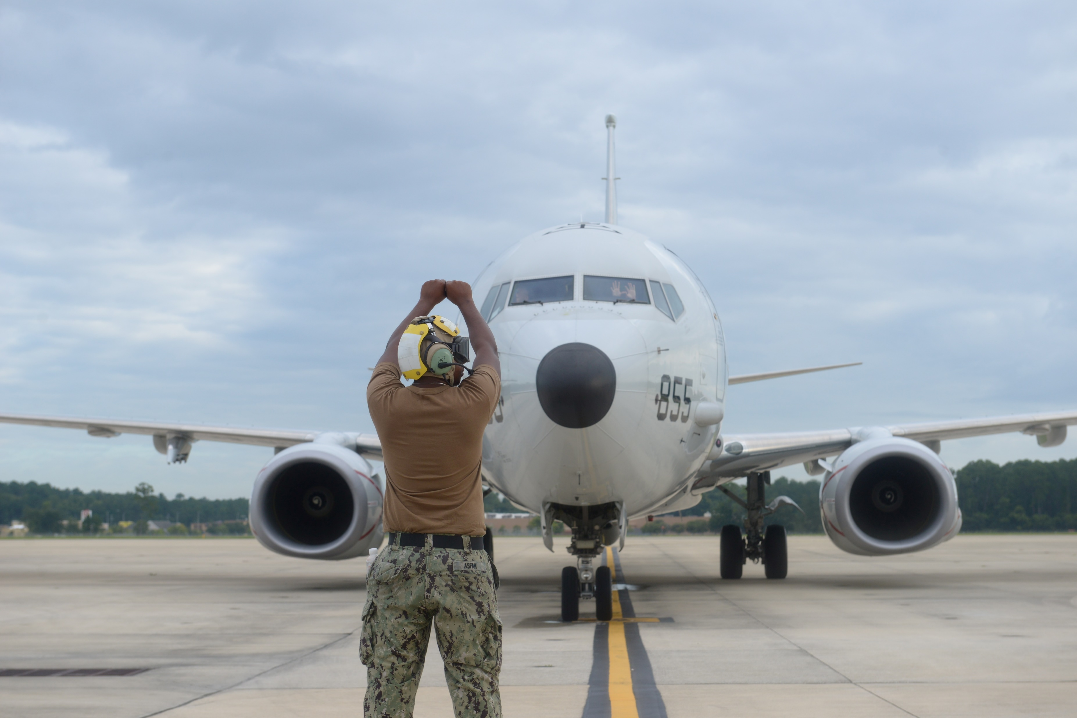
About the Technical Advisory Committee
Mission: To discuss relevant topics, provide expert opinion, follow up questions on assessment and adaptation, review preliminary findings and foster the identified outcomes toward implementation.

Slide 7
Meeting Objectives
Review data gaps
Review methodology
Confirm primary and secondary missions, mission-critical assets, and top shocks and stressors for each installation
Reach consensus on study boundary area

Slide 8
Project Overview
Notes:
Susy

Slide 9
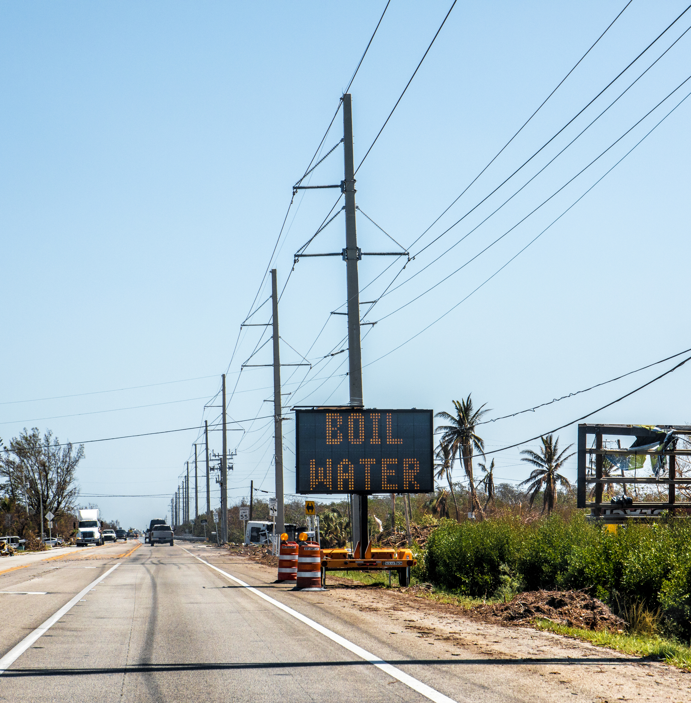
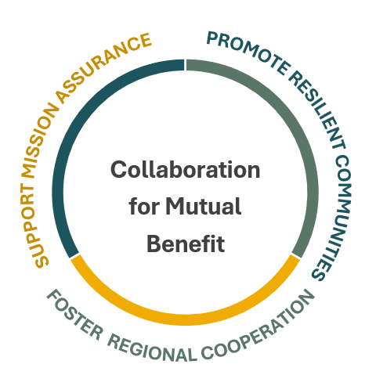
The purpose of the MIRR is to identify the risks, hazards, and vulnerabilities of concern as it relates to the ability of the military to carry out its missions on the installation that could be mitigated through investments and solutions outside the fence line in the community.

Slide 10









Pathway to Implementation
Pathway to Implementation
MIRR
Implementation
$$$
Others
Notes:
Rick

Slide 11
Implementation Success from other MIRRs
South Florida MIRR
October 2023
City of Key West Wastewater Treatment Plant Vulnerability Study
City of Doral Pedestrian Bridge
Emerald Coast MIRR October 2024
Eglin AFB Orphan Parcels Analysis
Bay County WTP Feasibility Study
^{East Central Florida MIRR}
^{August 2025}
Brevard County WWTP Feasibility Study*
Cocoa Water Redundant Connection to Patrick SFB*
*Note: these projects were fast-tracked by OLDCC.
Mission readiness through community resilience.

Slide 12
Data Gaps
Notes:
Susy

Slide 13
Data Gaps and Follow-Ups
Conversations with Mayport team
NAS JAX follow-ups
Camp Blanding data request
Follow-up discussions are being scheduled with:
CCUA
JEA
NS Mayport

Slide 14
Methodology Overview
Notes:
Susy

Slide 15
Project Methodology
Data Collection
Vulnerability Assessment/ Risk Analysis
Adaptation Strategy Development
Develop Implementation Plan

Slide 16
Blue-Print for Decision Making
Assets, Military Personnel, and Threats
Mission Lens Screening
Regional vs. Local
Vulnerability Assessment
Exposure Analysis
Sensitivity
Risk Analysis

Slide 17
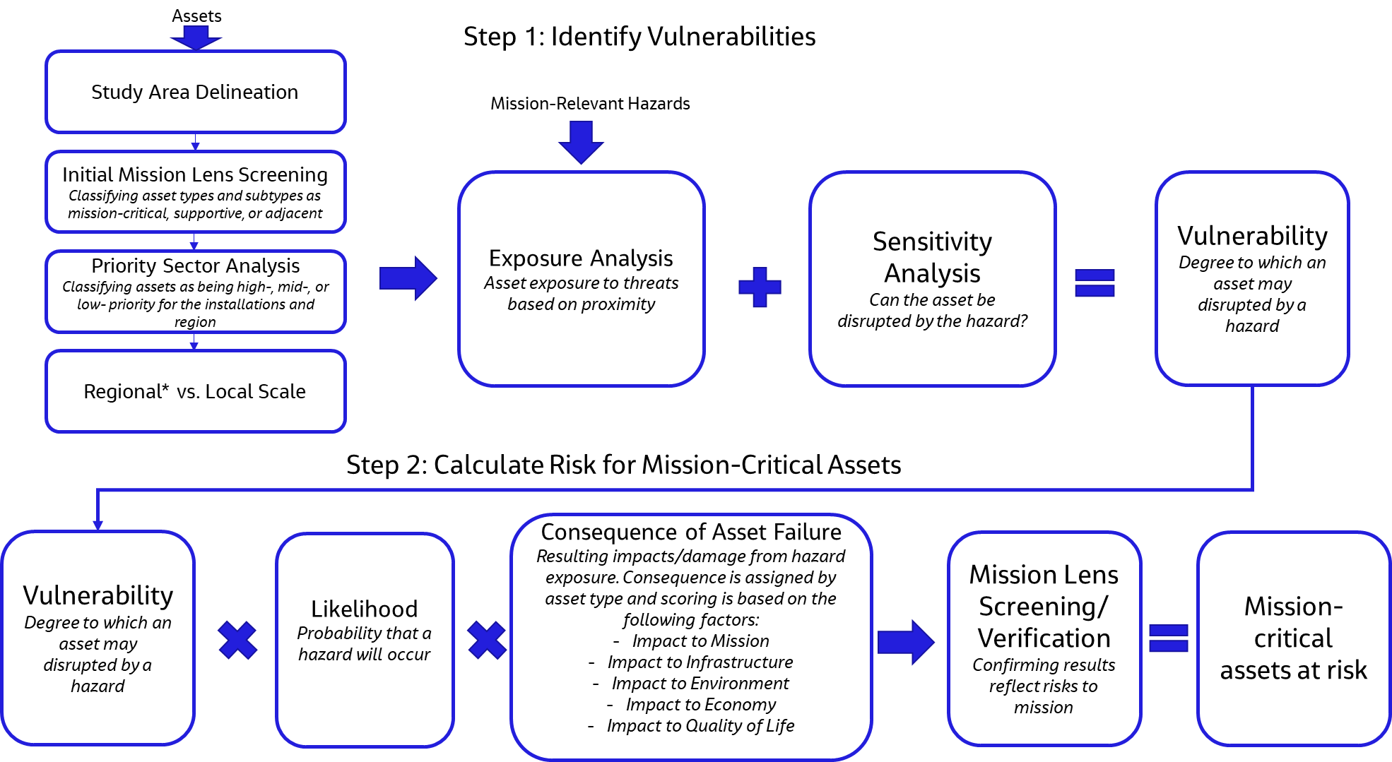
Vulnerability Assessment Methodology – Physical Infrastructure/ Assets

Slide 18
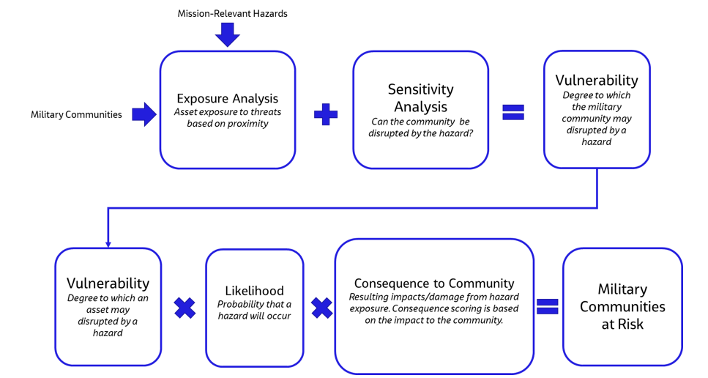
Vulnerability Assessment Methodology – Military Communities

Slide 19
Mission-Critical Lens - Assets
PRIMARY MISSION-CRITICAL ASSETS
MISSION-SUPPORTIVE ASSETS
Directly support the installation’s primary mission (failure/outage/disruption causes unacceptable disruption to mission operations)
Specifically identified as mission-critical by installation
Custom to each installation
Local scale
Indirectly support the installation’s missions (failure/outage/disruption causes inconvenience to mission operations, but short-term workarounds keep operations going)
Identified as supportive for high-performing operations by installation and community stakeholders
Local or regional scale
MISSION LENS
SECONDARY MISSION- CRITICAL ASSETS
ADDITIONAL VULNERABILITIES
Any additional vulnerabilities noted by stakeholders​ ​to natural, social, and economic infrastructure, or inside the fenceline
Directly support the installation’s secondary mission (failure/outage/disruption causes unacceptable disruption to mission operations)
Specifically identified as mission-critical by installation
Custom to each installation
Local scale
ADJACENT INFRASTRUCTURE
Not relevant to installation but within study area​

Slide 20








Threats and Hazards – Natural Hazards
Natural Hazards
Extreme Rainfall
High Wind
Storm Surge
Erosion
Sea Level Rise
Extreme Heat
Compound Flooding
Wildfire

Slide 21









Threats and Hazards – Other Shocks and Stresses
Physical Infrastructure & Services
Encroachment
Social/Human Stresses
Increasing Demands on Infrastructure (Capacity)
Light Pollution
Lack of Attainable Housing
Infrastructure Age
Land Development
Regulatory Requirements
1
Lack of Redundancy
Airspace Congestion
Transportation Congestion
T&E Species

Slide 22
Installation Visits Overview
Notes:
Susy

Slide 23
Naval Station Mayport

Slide 24
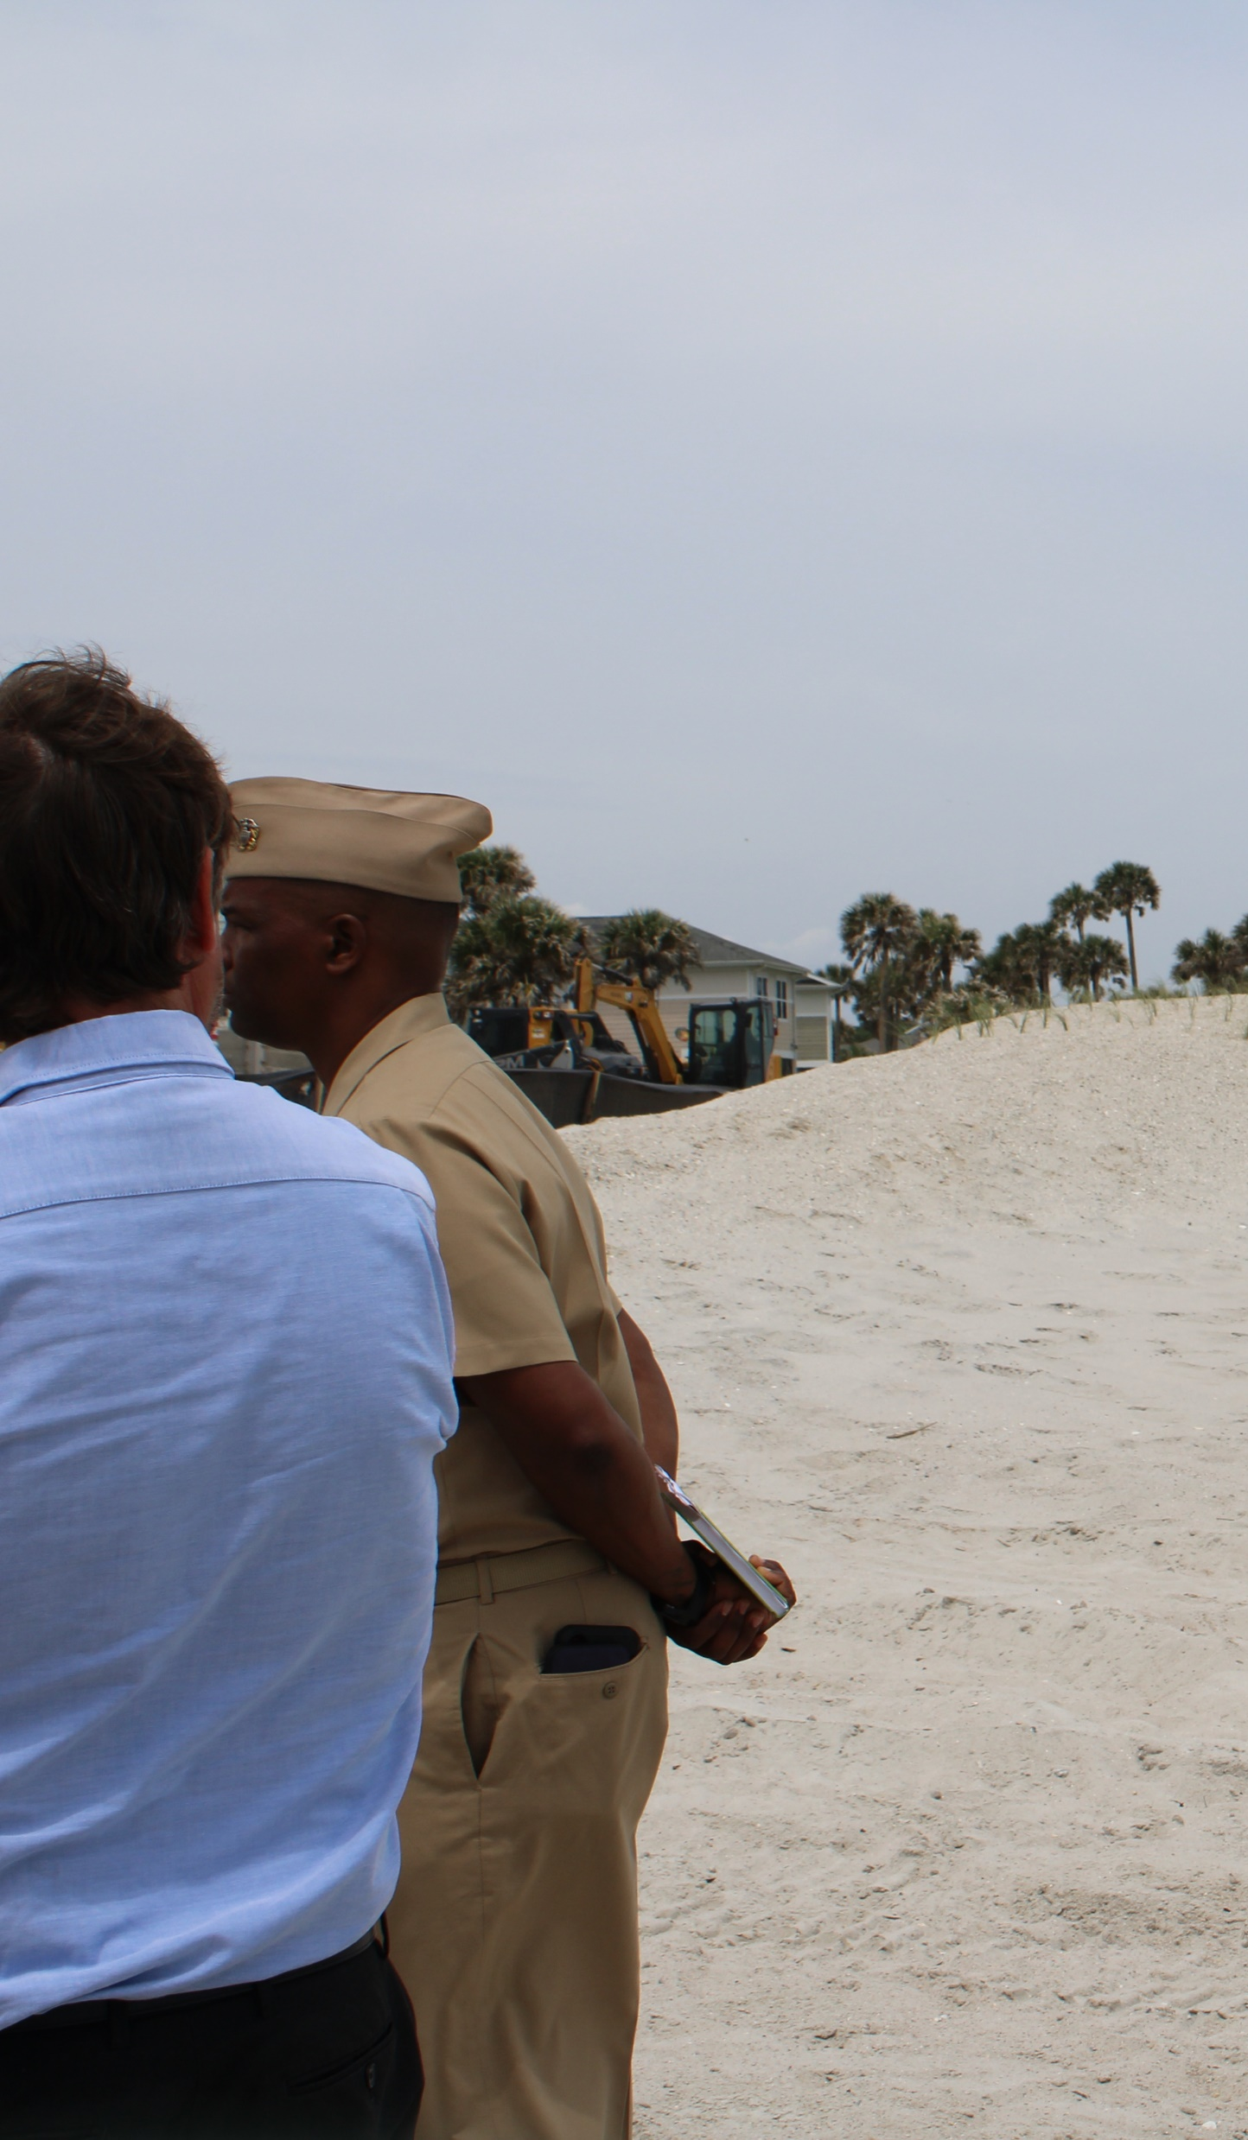
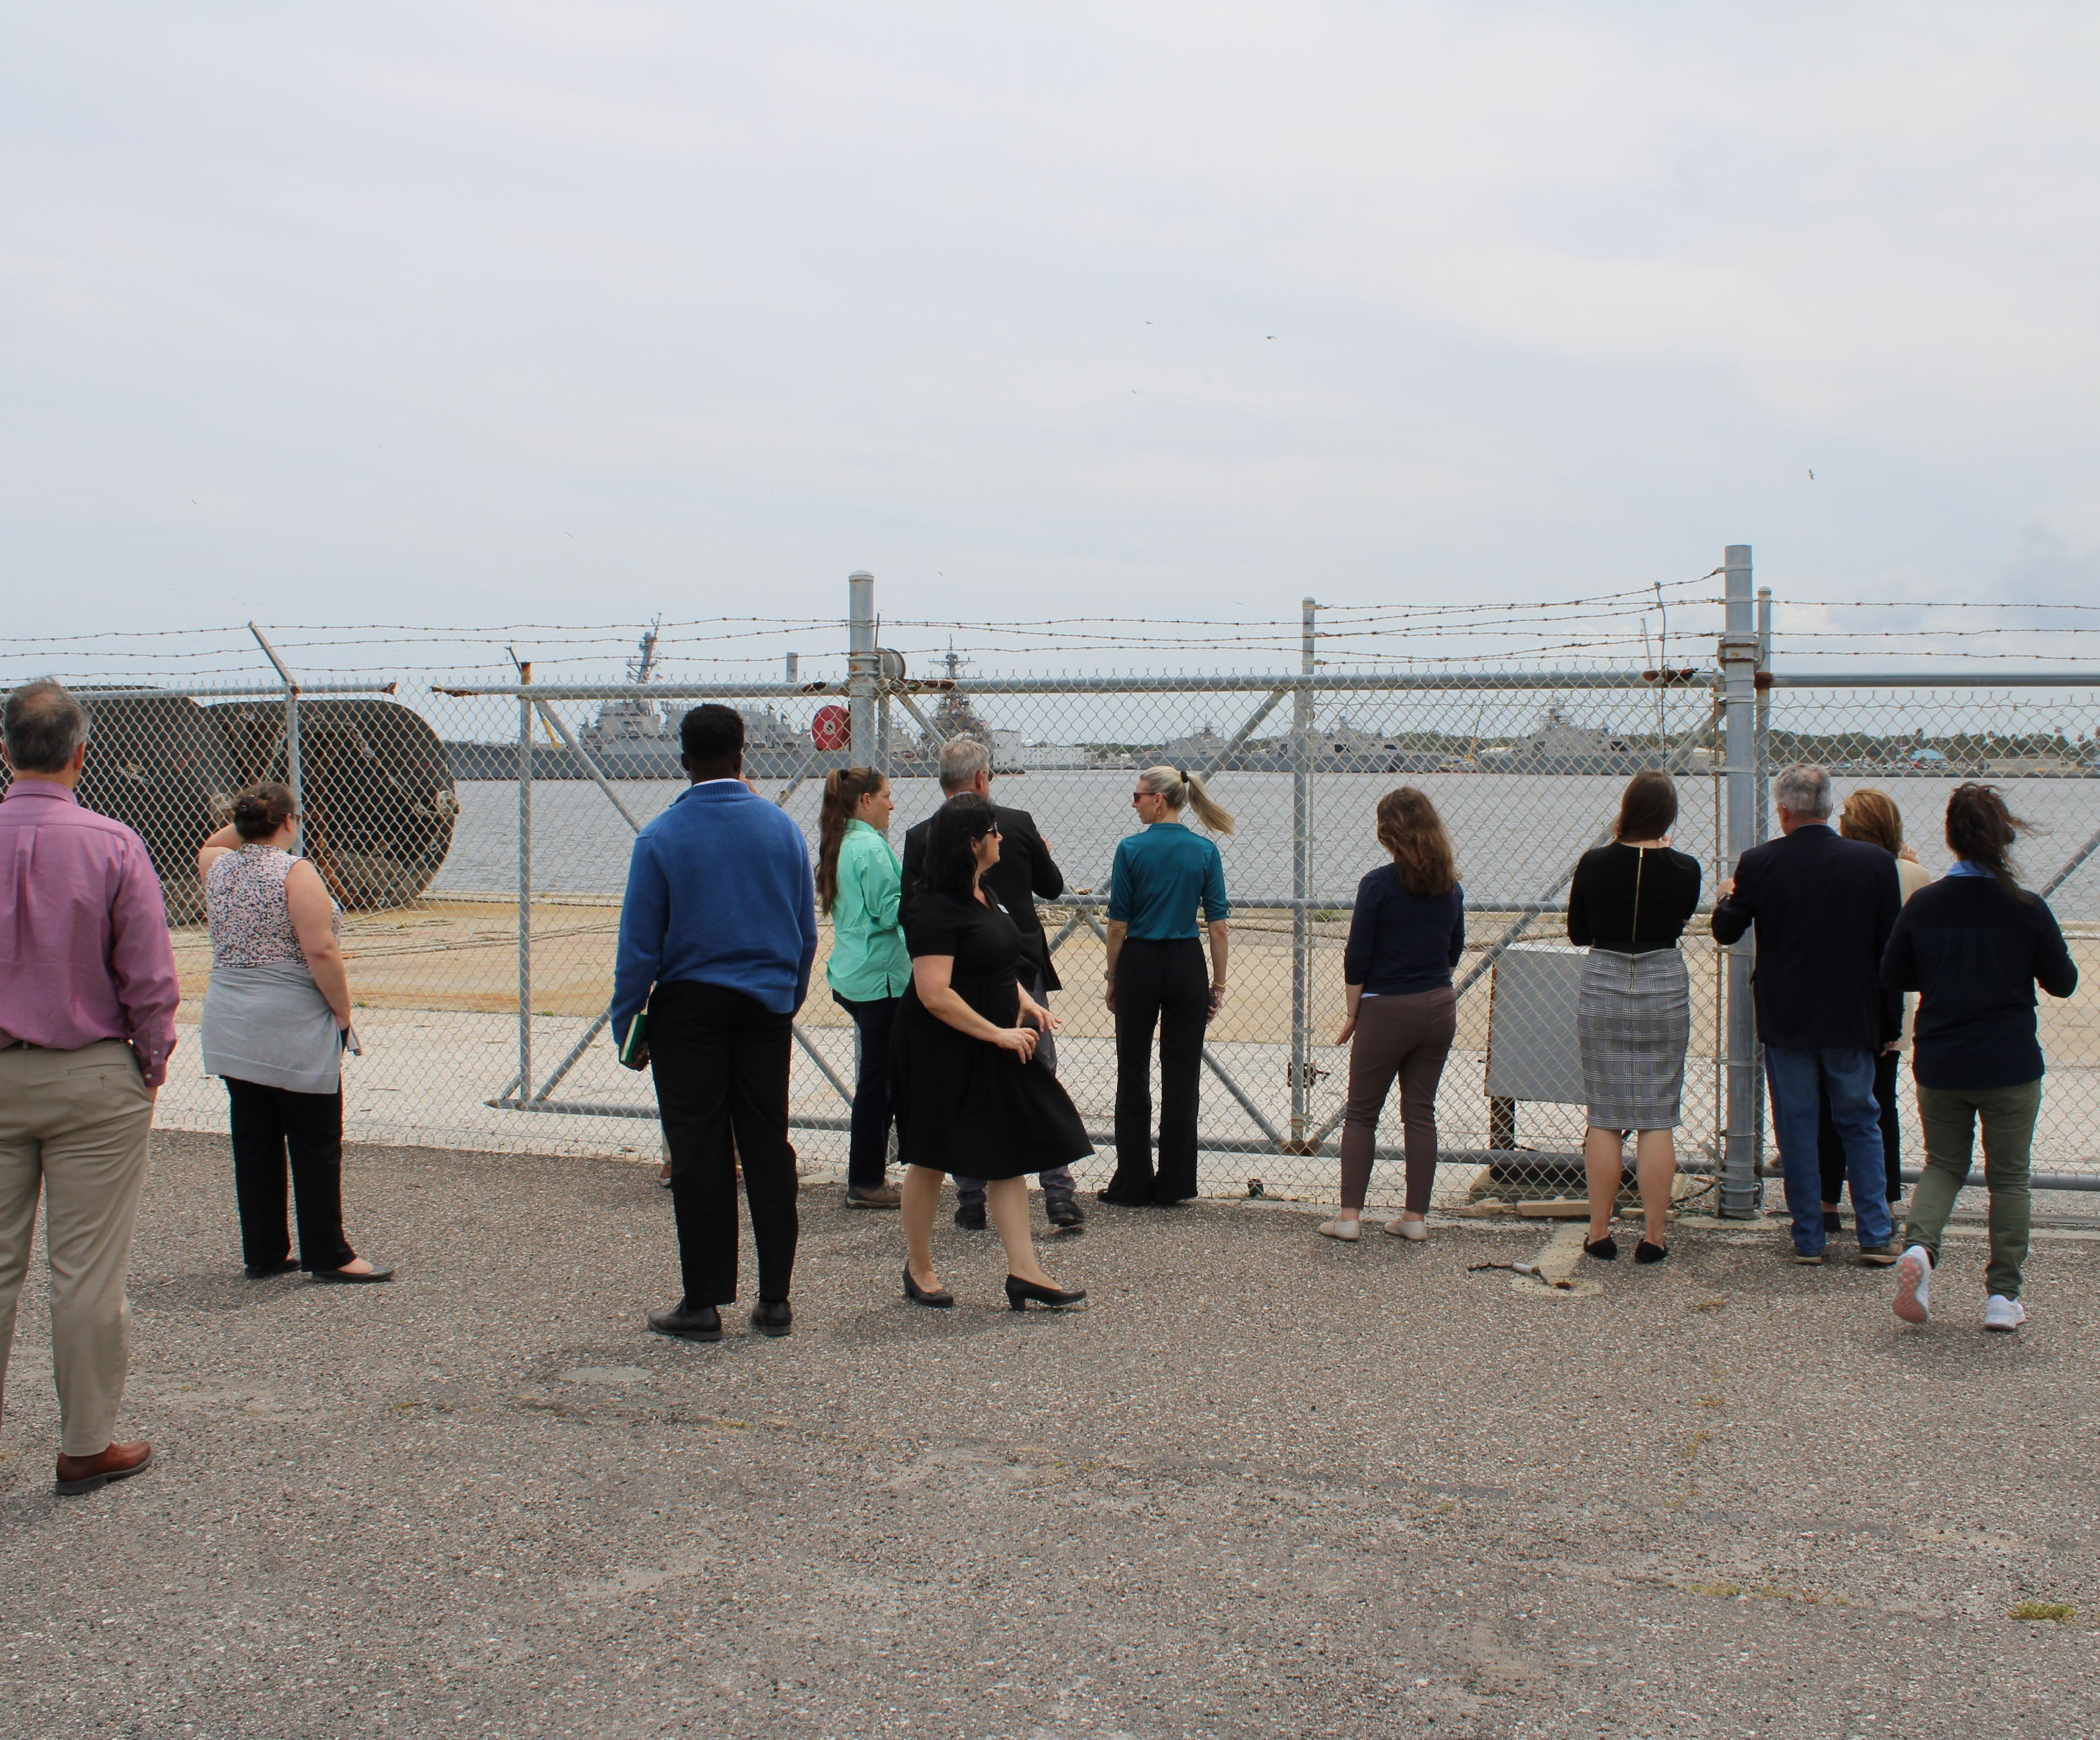
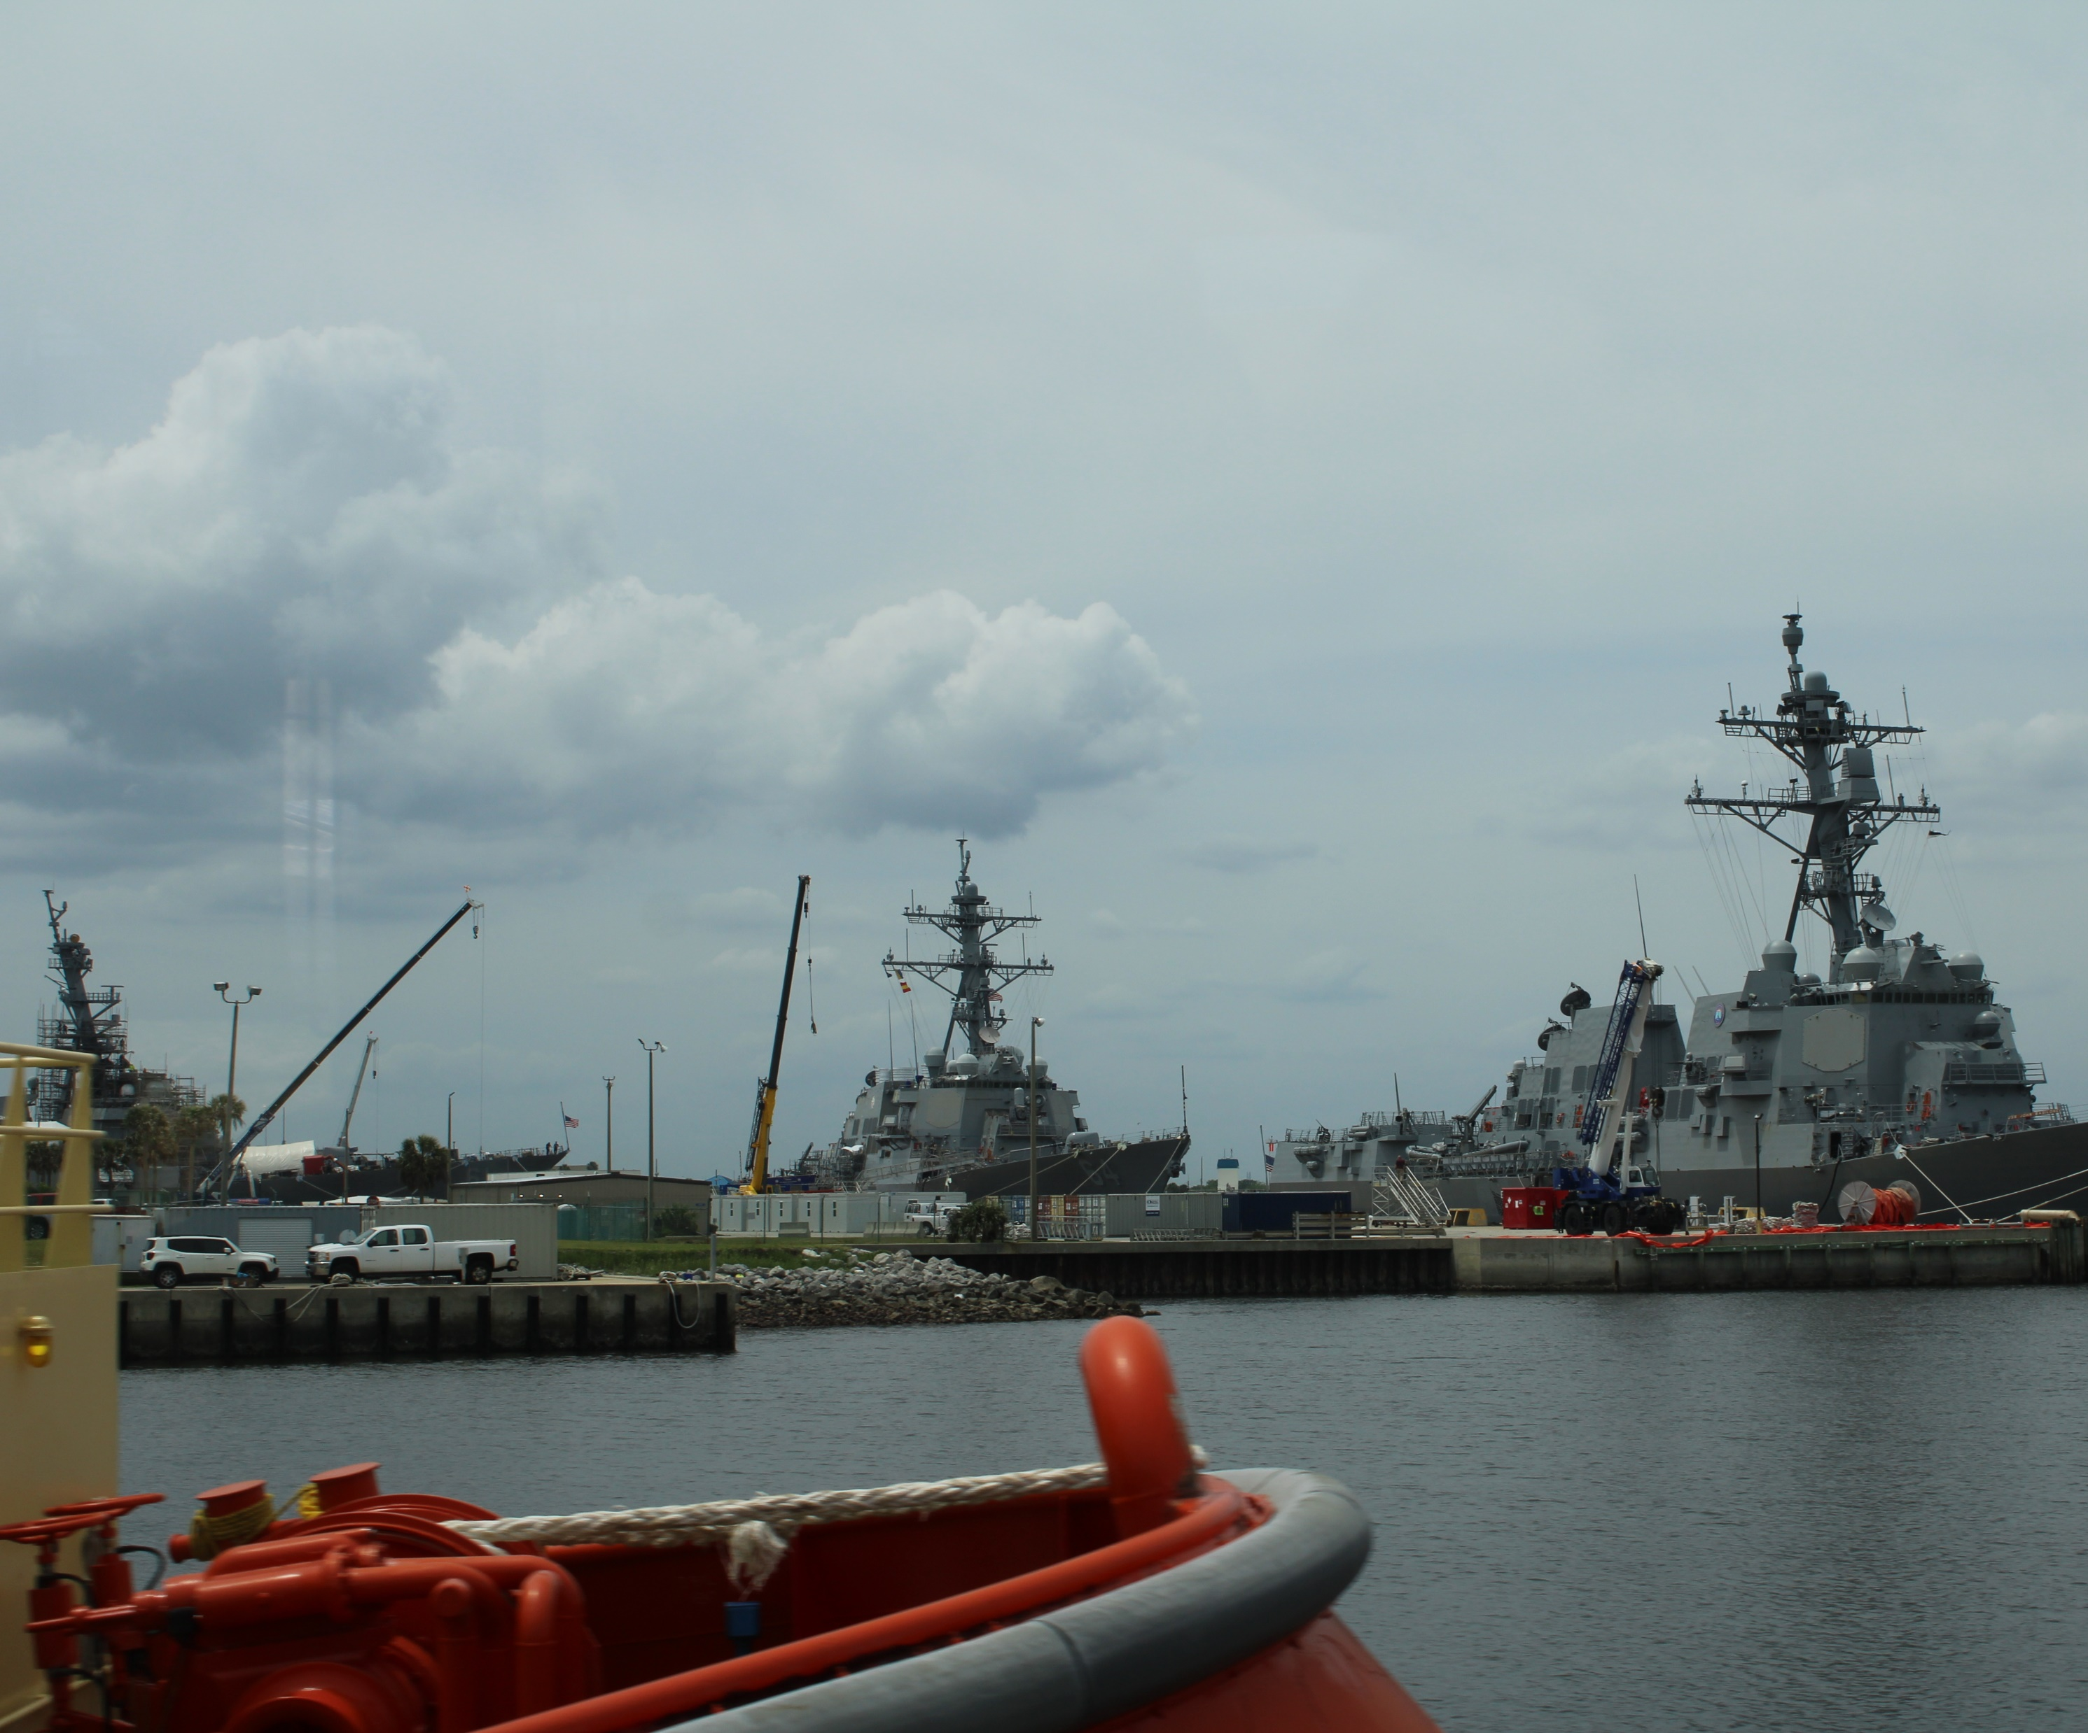
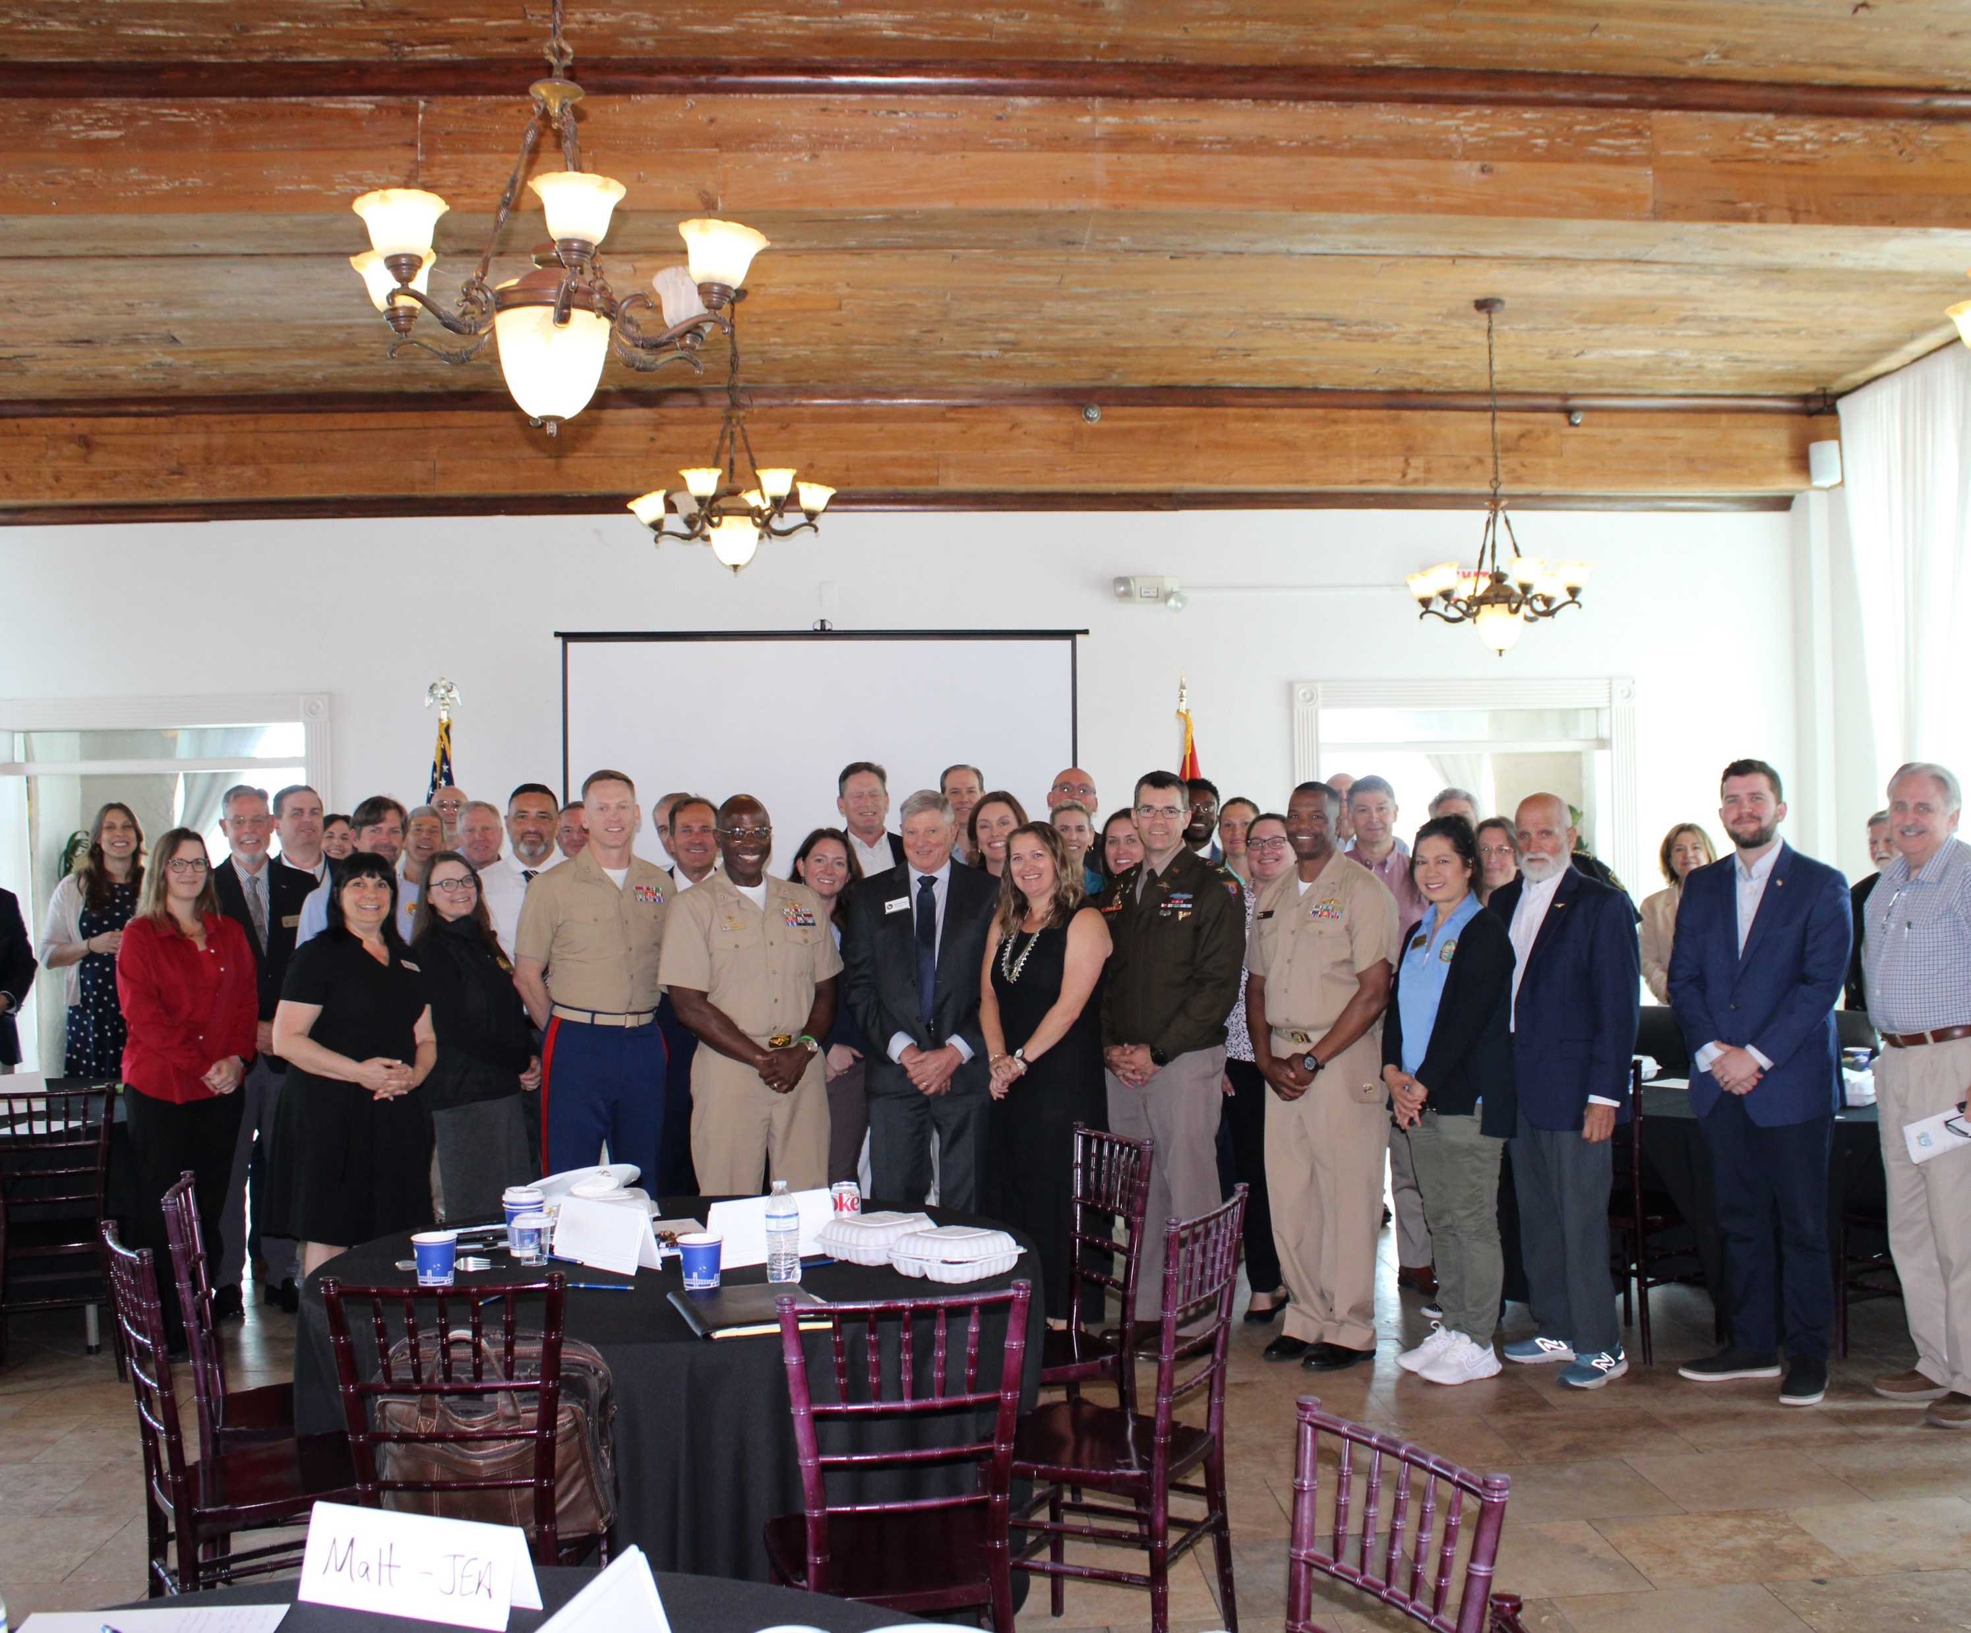
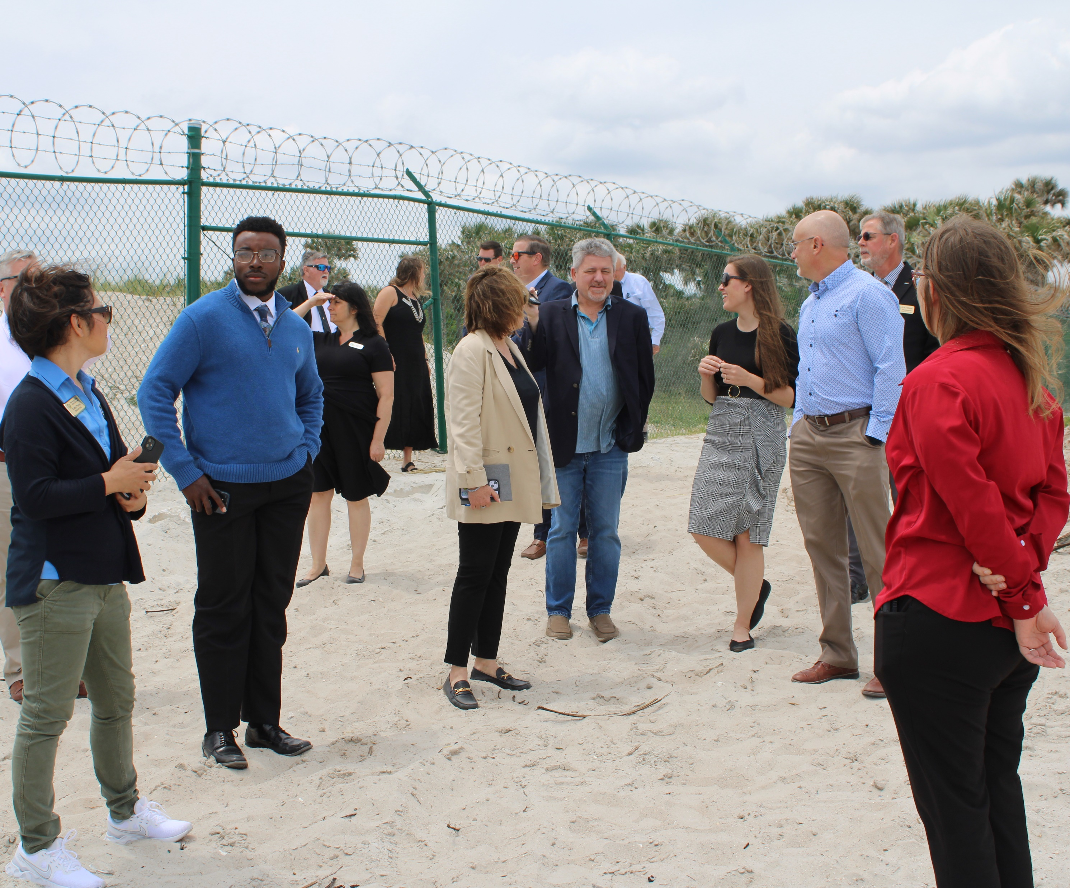
NS Mayport

Slide 25
Naval Station Mayport: Missions
Primary Mission
House and support assigned ships, helicopter squadrons, and unmanned aerial systems
Secondary Missions
Major ship repair
Offer regional fuel supply

Slide 26
Naval Station Mayport: Mission-Critical Assets
Primary
House and support the 4th Fleet, maintain and house UAVs, and repair major ships.
Secondary
Offer regional fueling depot.
Mission-Supportive
Assets that support the livelihood and health of installation personnel, indirect support to primary and secondary missions.
Location-Specific Positioning
Estuaries
Wetlands and Marshes
Shorelines
Assets Providing Direct Support
Electric Production and Supply Facilities
Roads and Bridges
Communications Facilities (e.g., cell towers, fiberoptic lines)
Assets Providing Direct Support
Emergency Response Facilities
Shorelines (Atlantic Coast shorelines)
Fire Stations
Personnel Support
Affordable Housing
Emergency Response Facilities (Hospitals)
Assets Providing Indirect Support
Solid and Hazardous Waste Facilities
26

Slide 27
Naval Station Mayport
Natural Hazards
Physical Infrastructure & Services
Extreme Rainfall
Increasing Demands on Infrastructure (Capacity)
Storm Surge
Infrastructure Age
1
Sea Level Rise
Lack of Redundancy
Compound Flooding
Transportation Congestion
High Wind
Social/Human Hazards
Lack of Attainable Housing
Erosion
Extreme Heat

Slide 28
Marine Corp Support Facility Blount Island

Slide 29
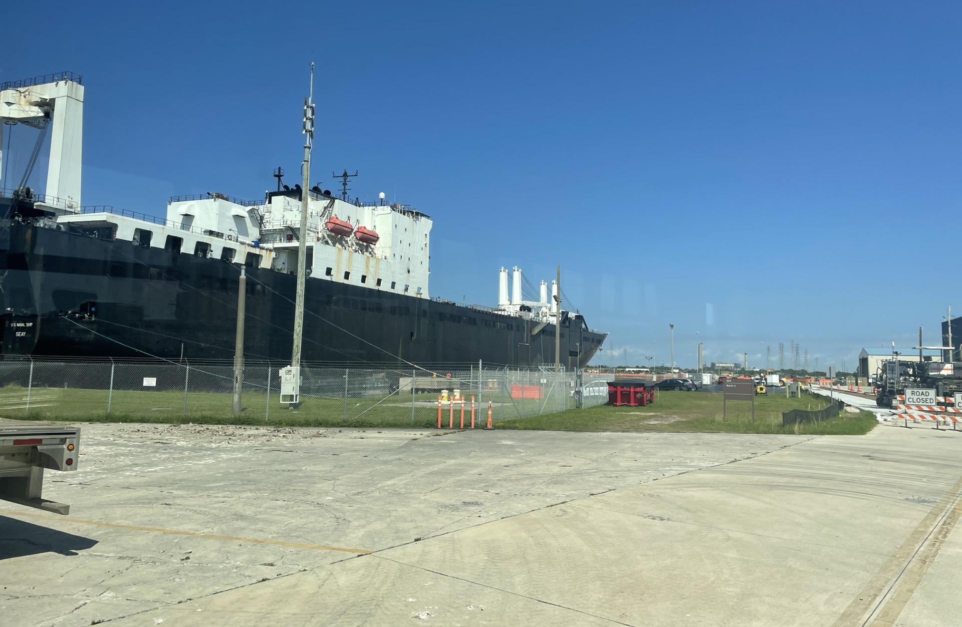
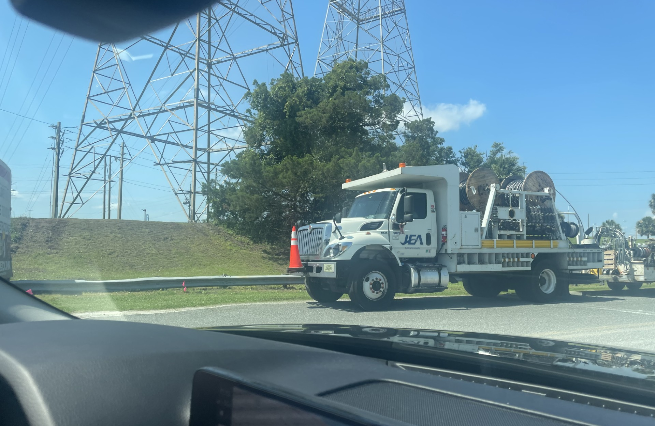
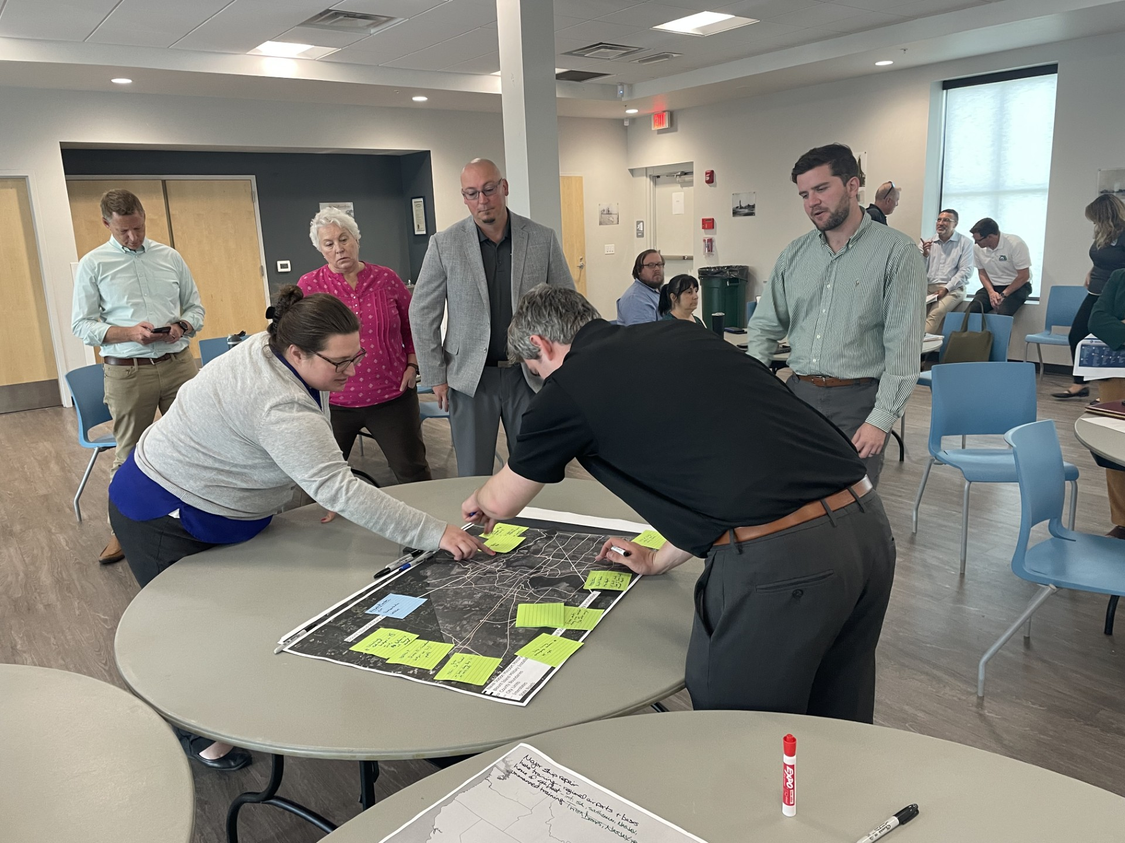
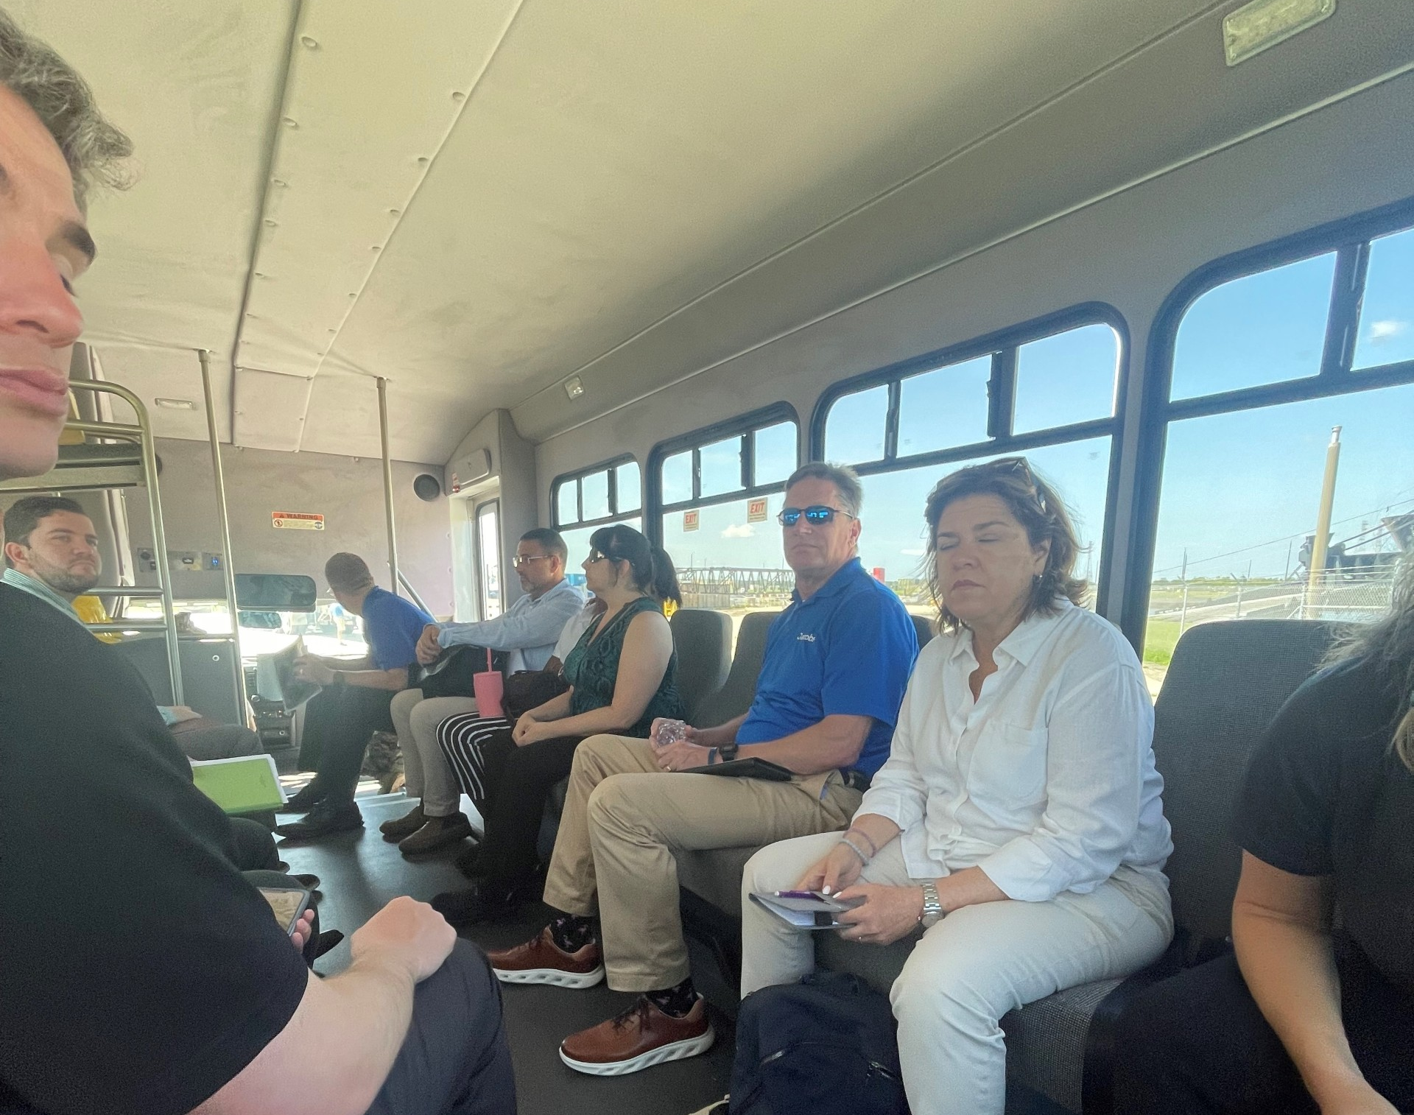
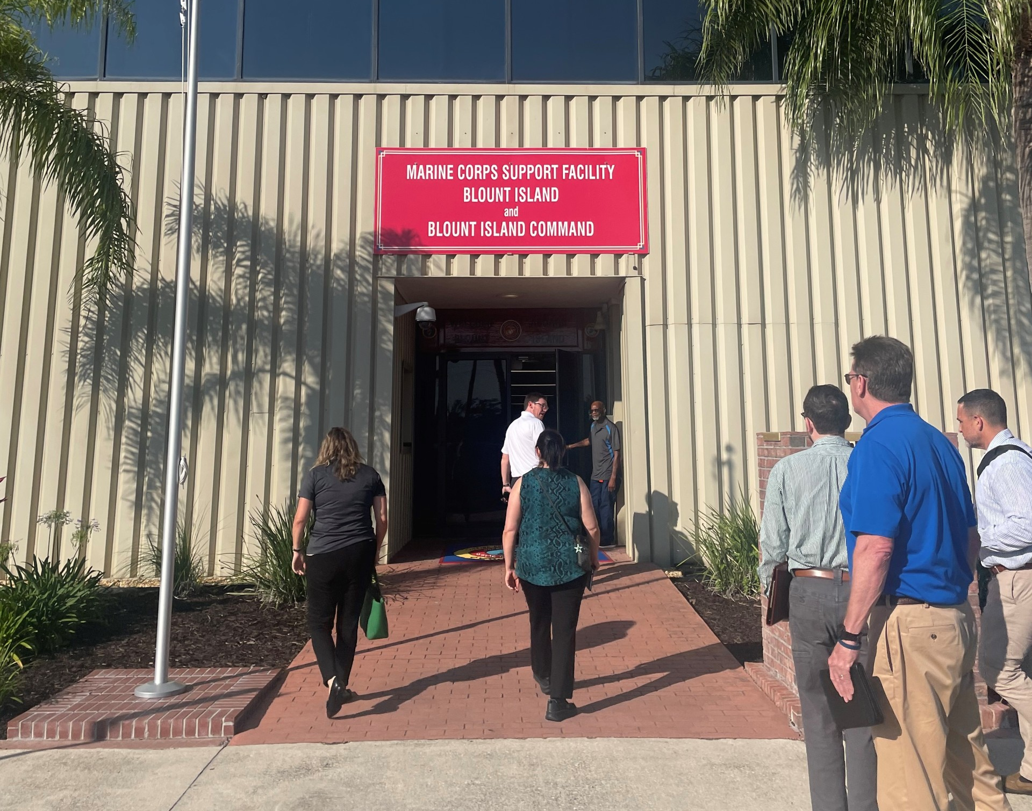
MCSF Blount Island
Notes:
Alec

Slide 30
MCSF Blount Island: Missions
Primary Mission
Support readiness of Marine pre-positioning
Support crisis response through rapid loading and deployment of ships
Secondary Mission
Ship repair
Naval cargo handling battalion
Notes:
Aka they put stuff on ships

Slide 31
MCSF Blount Island: Mission-Critical Assets
Primary
Support crisis response
Secondary
Naval battalion/marine ship repair
Mission-Supportive
Assets that support the livelihood and health of installation personnel, indirect support to primary and secondary missions.
Location-Specific Positioning
Rivers (St. John’s River)
Shorelines
Assets Providing Direct Support
Electric Production and Supply Facilities
Roads and Bridges
Rail systems
Communications systems
Assets Providing Direct Support
Water systems
Wastewater systems
Personnel Support
Affordable Housing
Emergency Response Facilities (Fire Stations)
Assets Providing Indirect Support
Solid and Hazardous Waste Facilities
31

Slide 32


MCSF Blount Island: Shocks and Stresses
Natural Hazards
Physical Infrastructure & Services
Extreme Rainfall
Infrastructure Age
1
Compound Flooding
Lack of Redundancy
High Wind
Encroachment
Extreme Heat
Land Development
Wildfire
Natural Systems
T&E Species Management Challenges

Slide 33
Camp Blanding Joint Training Facility

Slide 34
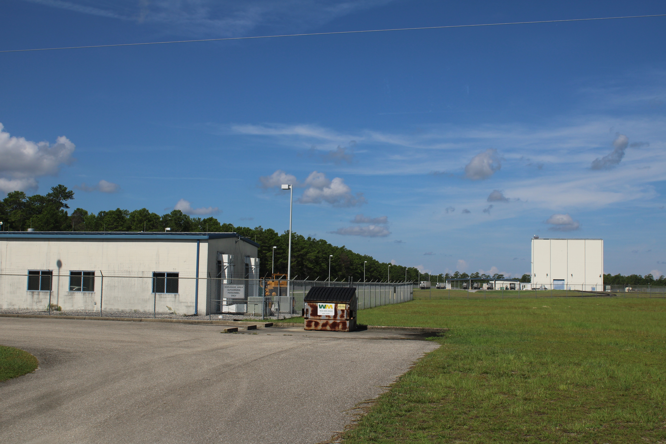
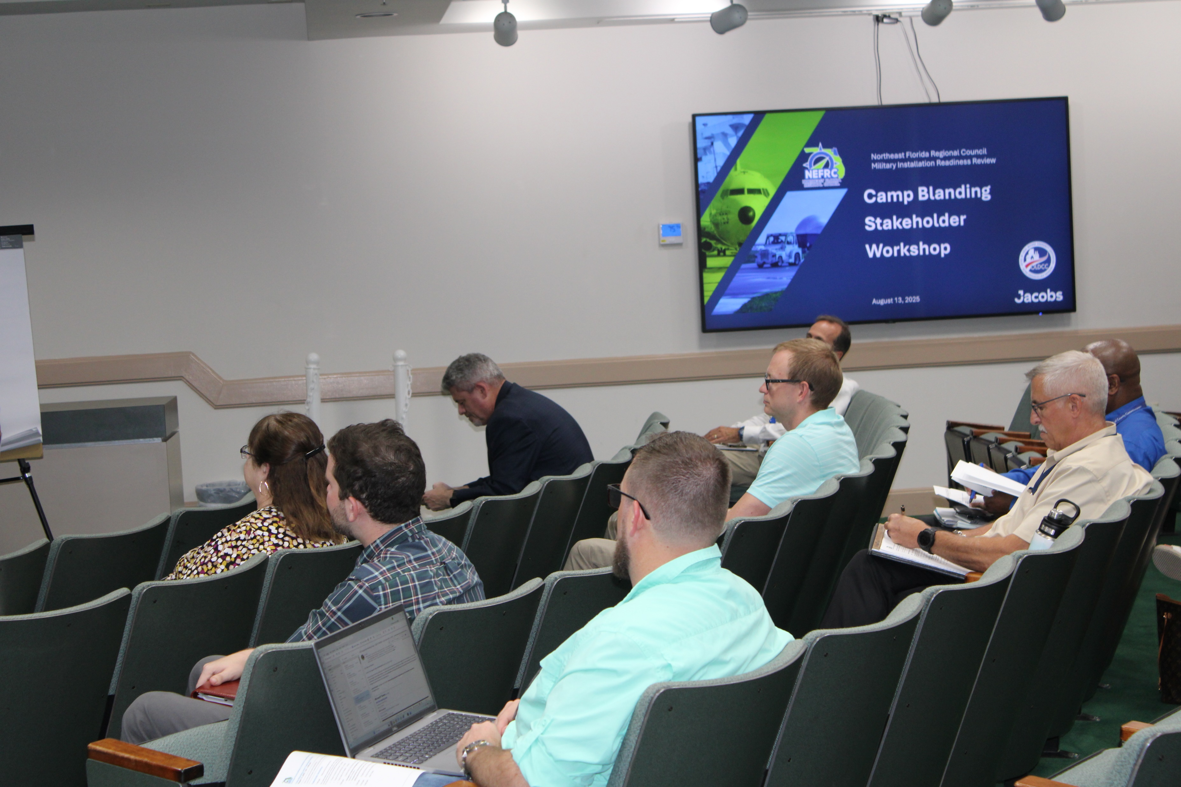
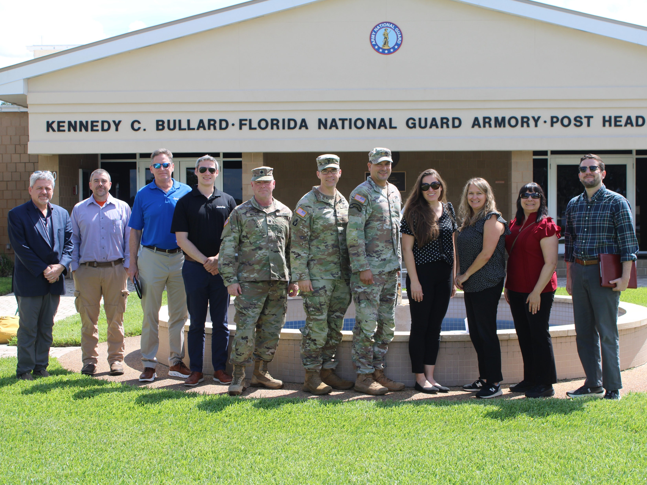
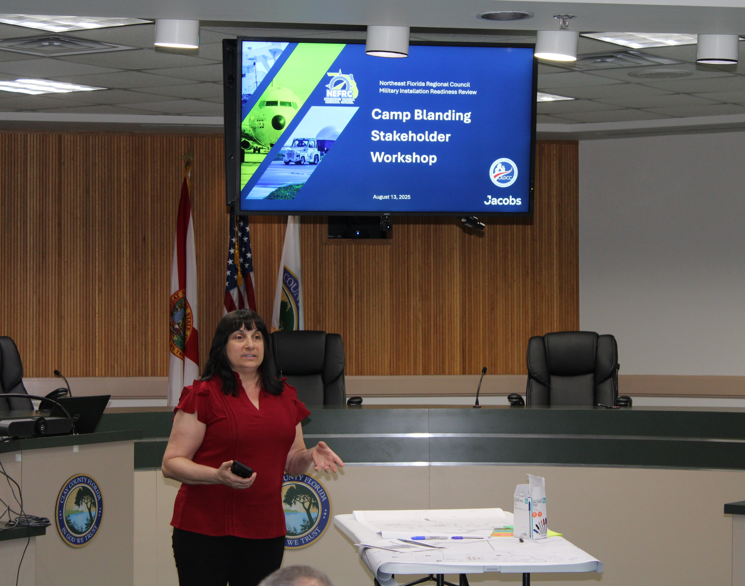
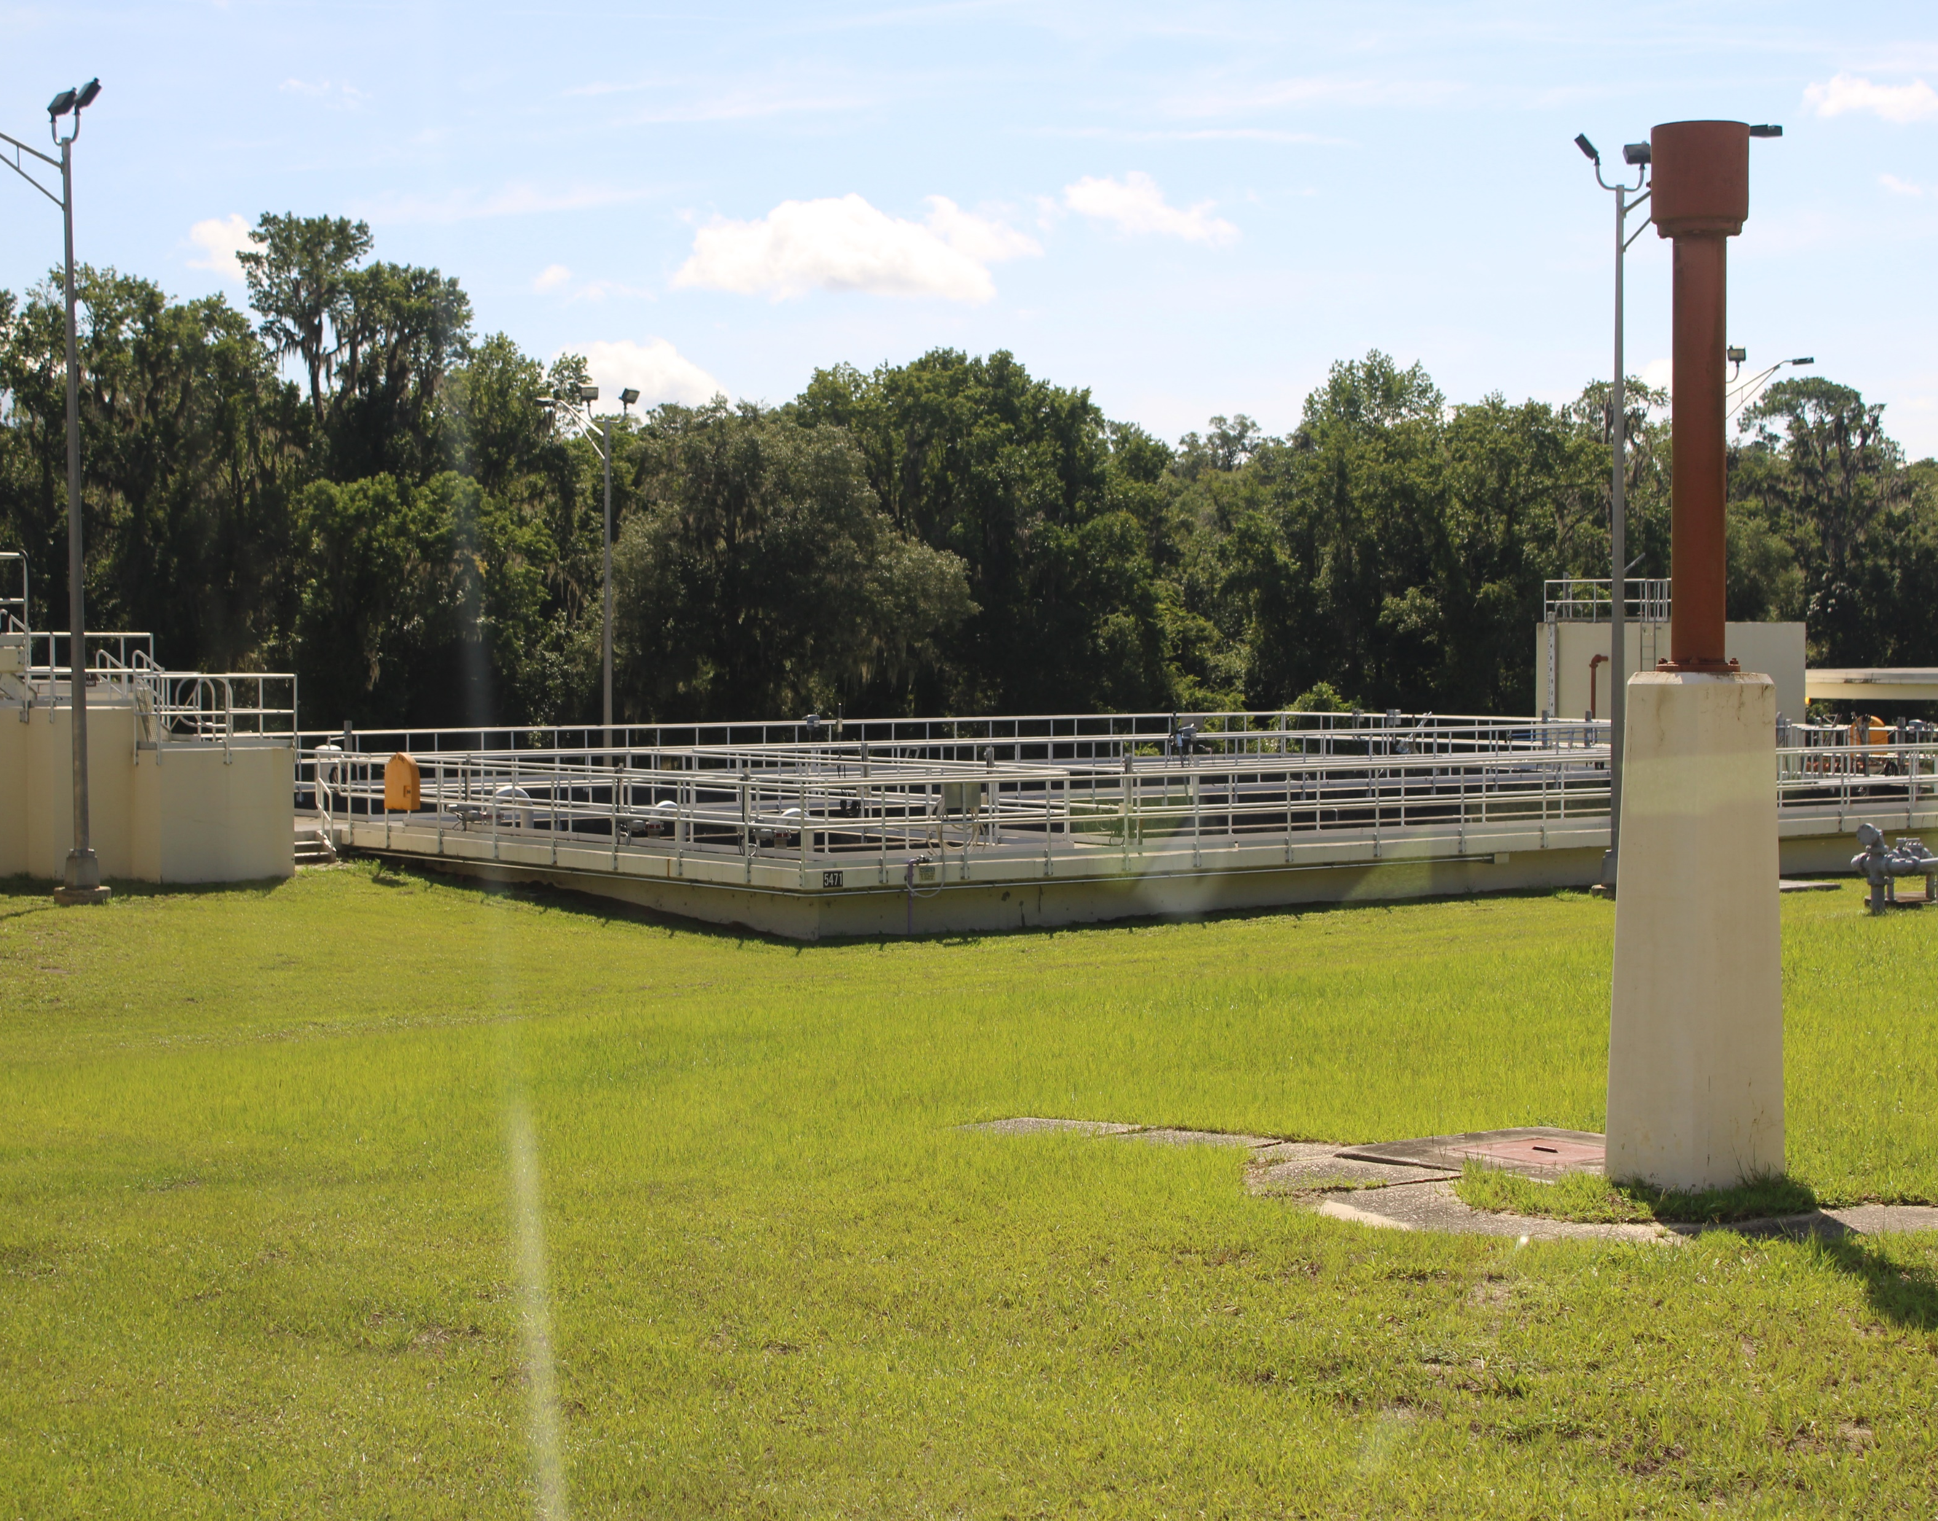
Camp Blanding

Slide 35
Camp Blanding Joint Training Facility: Missions
Primary Mission
Level 2 Garrison Training and Impact Area (supporting ground maneuver)
Secondary Mission
Support state and federal activities
Training ground for various federal and state agencies
FL state backup EOC

Slide 36
Camp Blanding JTF: Mission-Critical Assets
Primary
Level 2 Garrison Training Area (supporting ground maneuver)
Secondary
Support state and federal activities
Mission-Supportive
Assets that support the livelihood and health of installation personnel, indirect support to primary and secondary missions.
Location-Specific Positioning
Conservation lands
Assets Providing Direct Support
Electric Production and Supply Facilities
Roads and Bridges
Rail systems
Communications systems
Fire stations
Stormwater systems
Assets Providing Direct Support
Water systems
Wastewater systems
Personnel Support
Affordable Housing
Assets Providing Indirect Support
Solid and Hazardous Waste Facilities
36

Slide 37
Camp Blanding JTF: Shocks and Stresses
Natural Hazards
Physical Infrastructure & Services
Social/Human Stresses
Extreme Rainfall
Infrastructure Age
Lack of Attainable Housing
1
Compound Flooding
Lack of Redundancy
Regulatory Requirements
High Wind
Encroachment
Extreme Heat
Land Development
Wildfire
T&E Species
Notes:
Encroachment (development, management of threatened and endangered species)
Power supply redundancy
Impacts to trust fund revenue stream
Wastewater (WWTP disposal changes, SB 64)

Slide 38
Naval Air Station Jacksonville

Slide 39
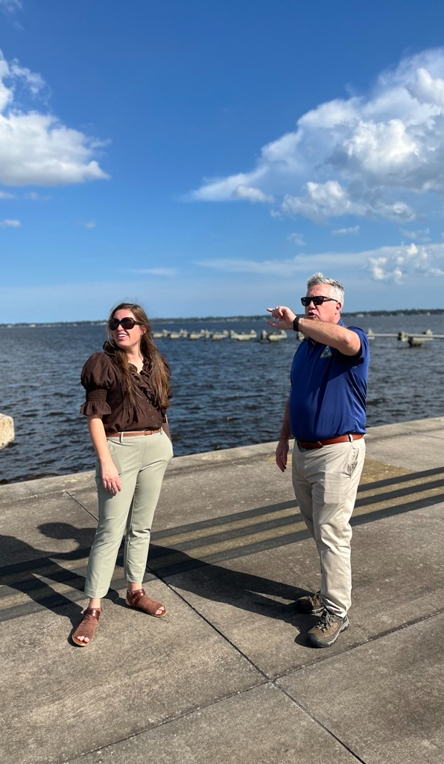
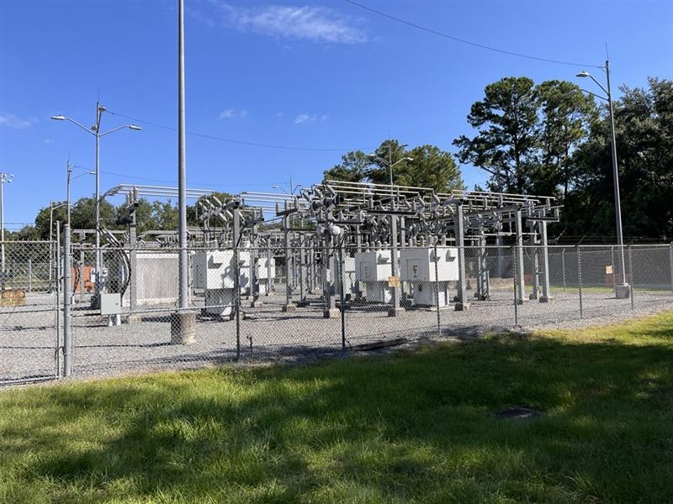
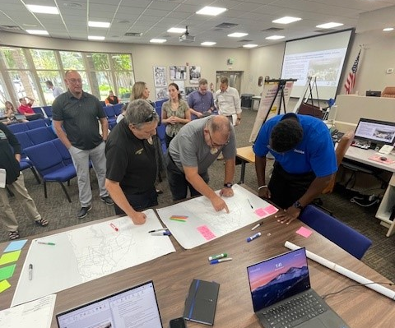
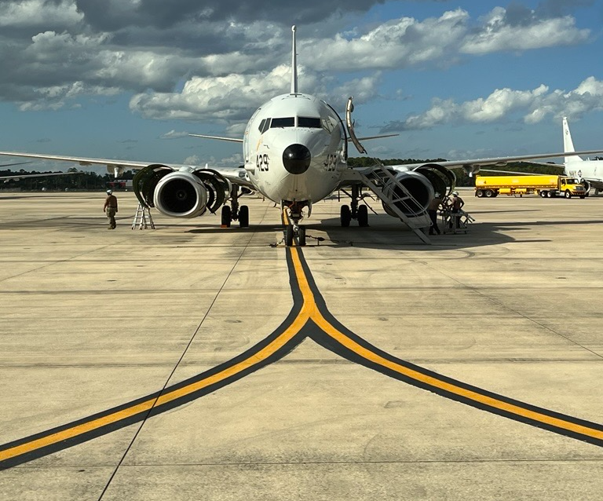
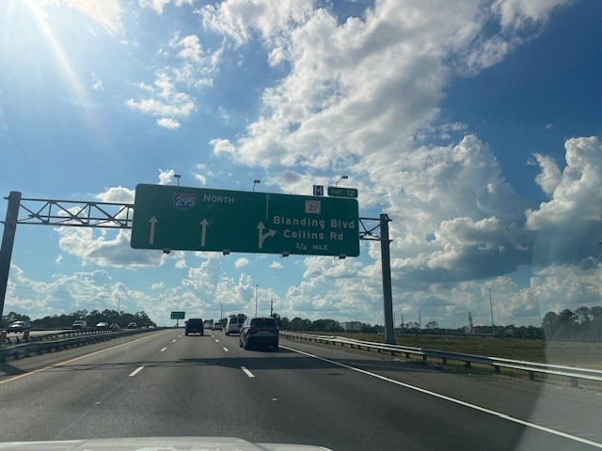
NAS Jacksonville
Notes:
Alec

Slide 40
Naval Air Station Jacksonville: Missions
Primary Mission
Training and Operations
Logistical + Maintenance Support
Secondary Missions
UAV Operations
Naval Hospital
Custom / Border Patrol
Base support for airport regional commands

Slide 41
NAS Jacksonville: Mission-Critical Assets
Primary
Conduct training and operations
Logistical and maintenance support
Secondary
Drone operations, Naval Hospital, Support regional commands, Customs and Border Patrol
Mission-Supportive
Assets that support the livelihood and health of installation personnel, indirect support to primary and secondary missions.
Location-Specific Positioning
Conservation lands
Shorelines
Assets Providing Direct Support
Electric Production and Supply Facilities
Roads and Bridges
Rail systems
Airports
Natural gas supply systems
Assets Providing Direct Support
Water systems
Wastewater systems
Communications systems
Regional hospitals
Personnel Support
Affordable housing
Childcare facilities
Assets Providing Indirect Support
Solid and Hazardous Waste Facilities
Stormwater systems
41

Slide 42
NAS Jacksonville: Shocks and Stresses
Natural Hazards
Physical Infrastructure & Services
Encroachment
Extreme Rainfall
Infrastructure Age
Light Pollution
Compound Flooding
1
Land Development
Lack of Redundancy
High Wind
Transportation Congestion
Airspace Congestion
Extreme Heat
Social/Human Hazards
Wildfire
Lack of Attainable Housing
Erosion
Regulatory Requirements

Slide 43
Study Area Boundary
Notes:
Susy

Slide 44
Study Area Boundary
Study area boundaries define the area that will be covered by the vulnerability assessment and adaptation projects
Includes hazards and mission-critical assets

Slide 45
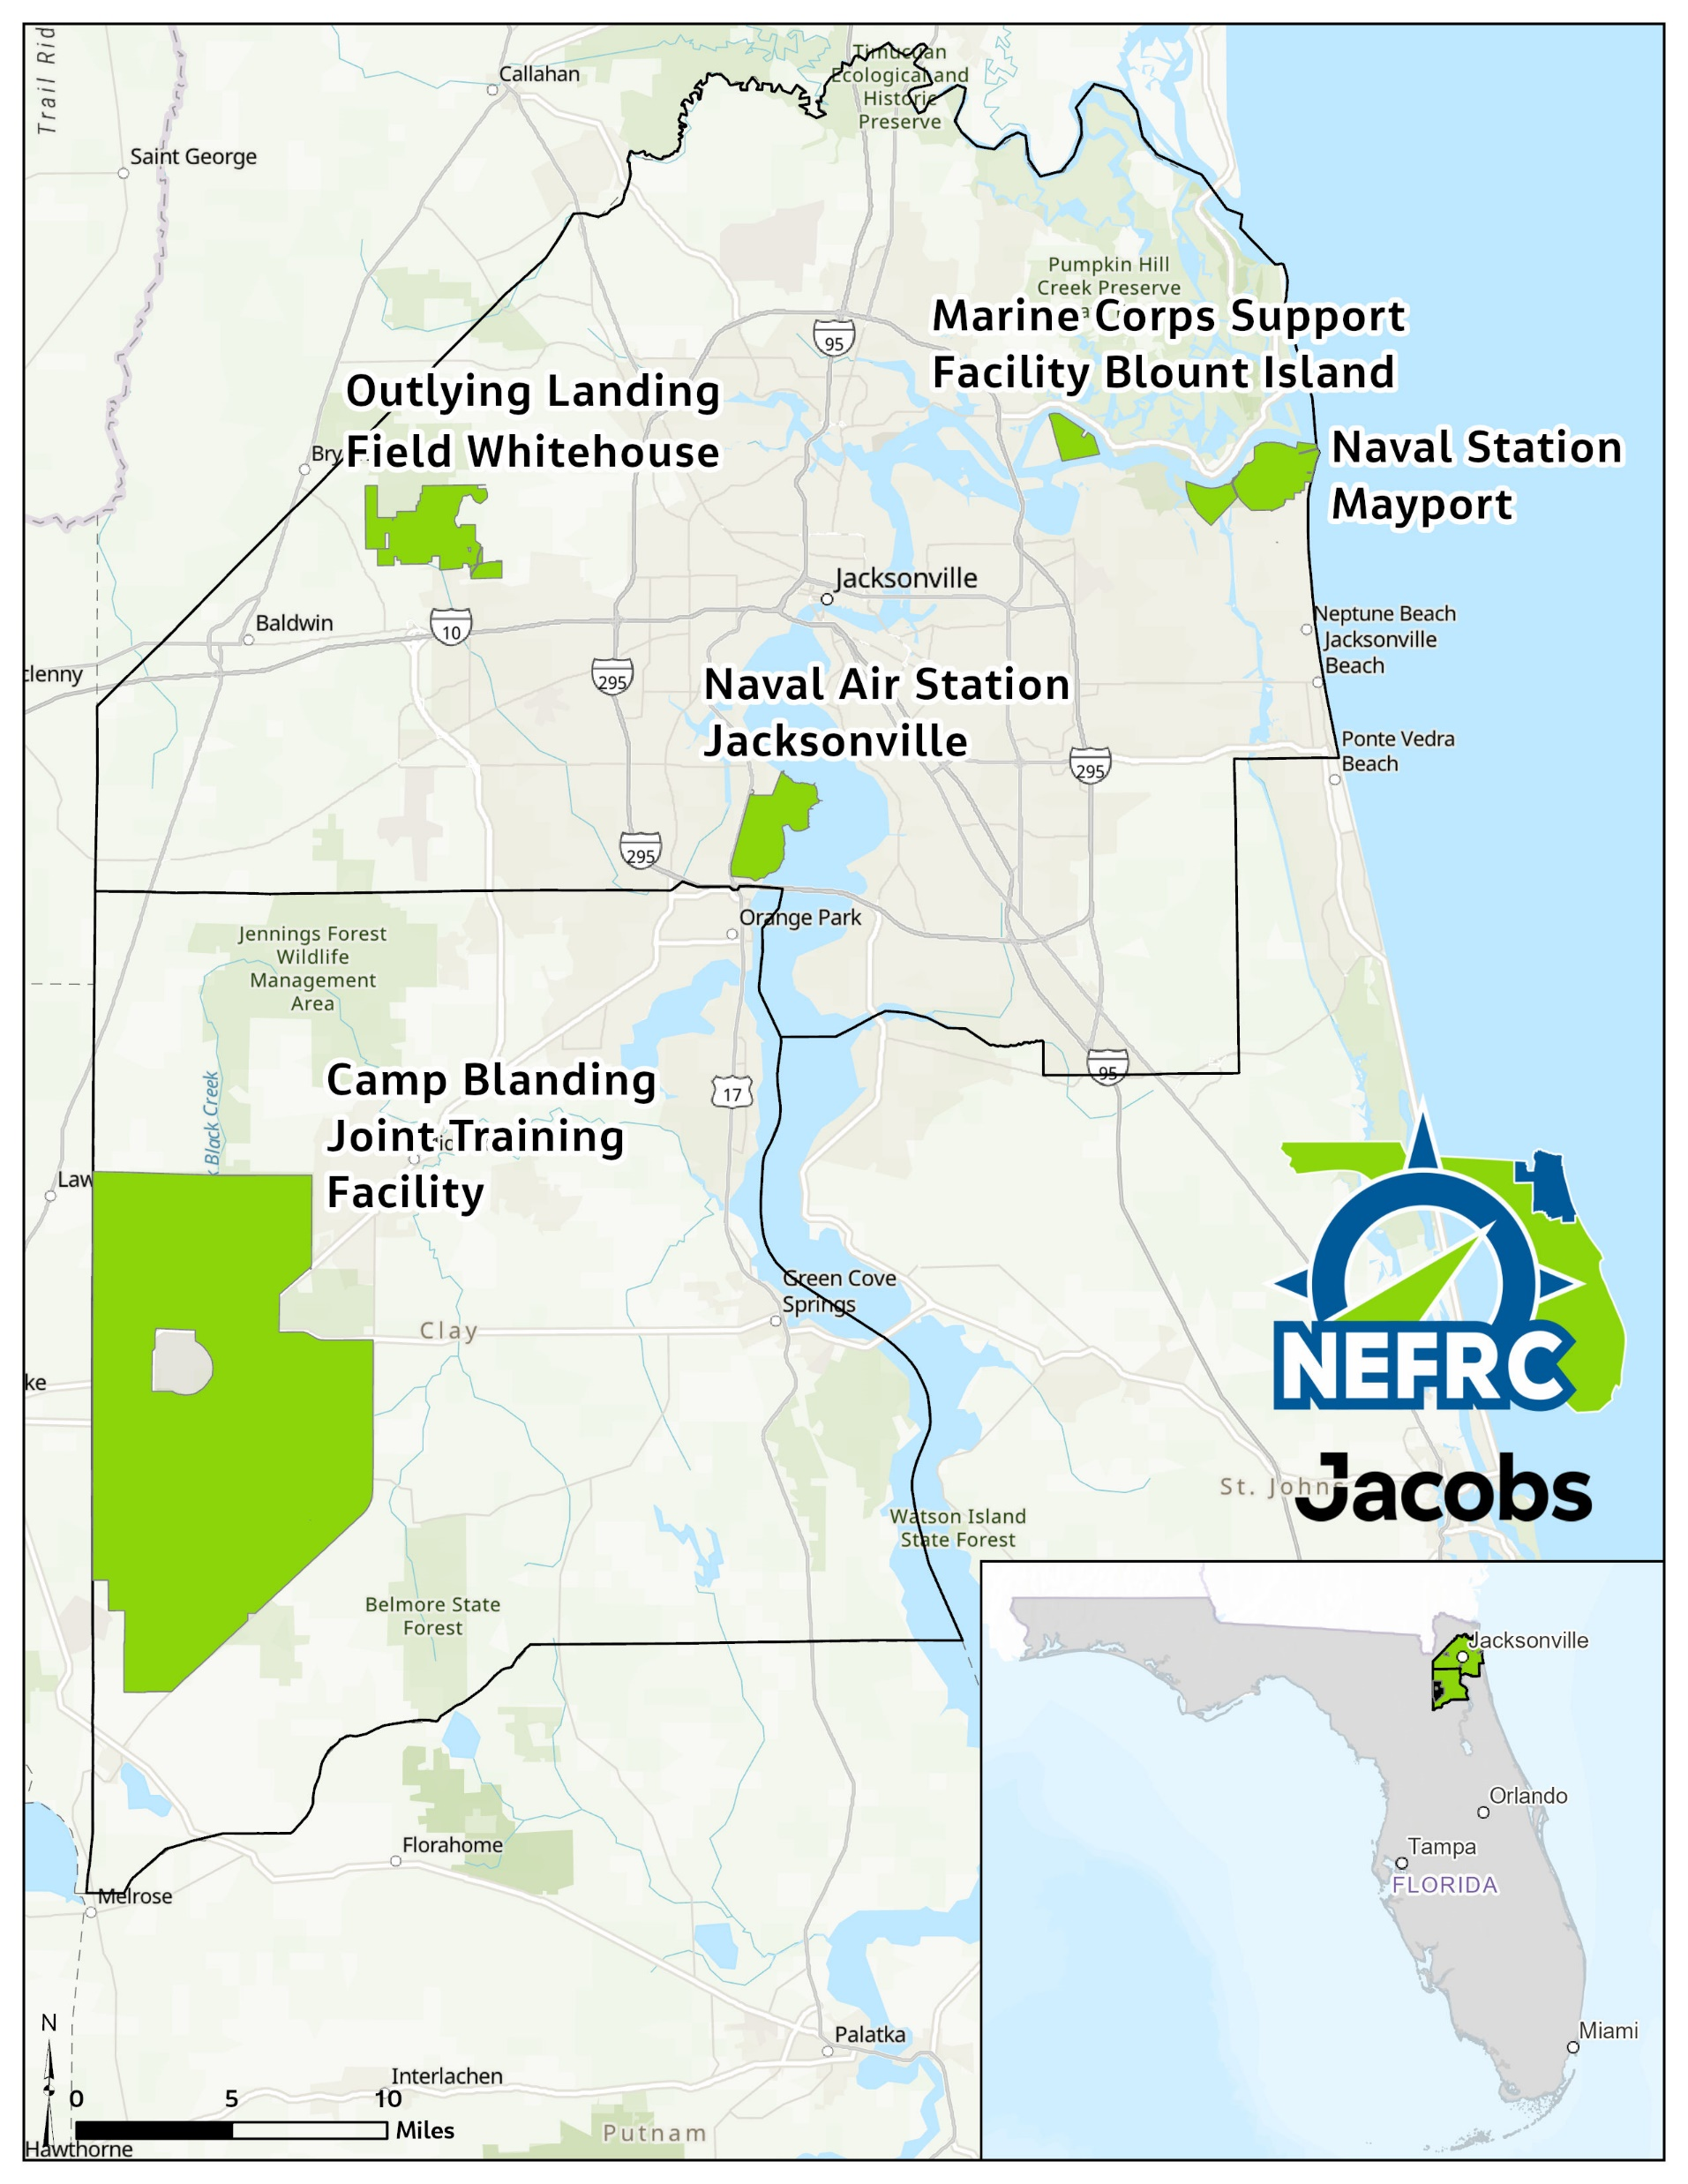
Proposed Study Area Boundary

Slide 46
Next Steps & Questions
Notes:
Susy

Slide 47
Next Steps & Questions
Next TAC Meeting – November
Mutual Support Agreements / Community Partnerships
Emergency Management Exercise – May 2026

Slide 48
Northeast Florida Regional Council Military Installation Resilience Review
Thank You
September 30, 2025

